Slide 1
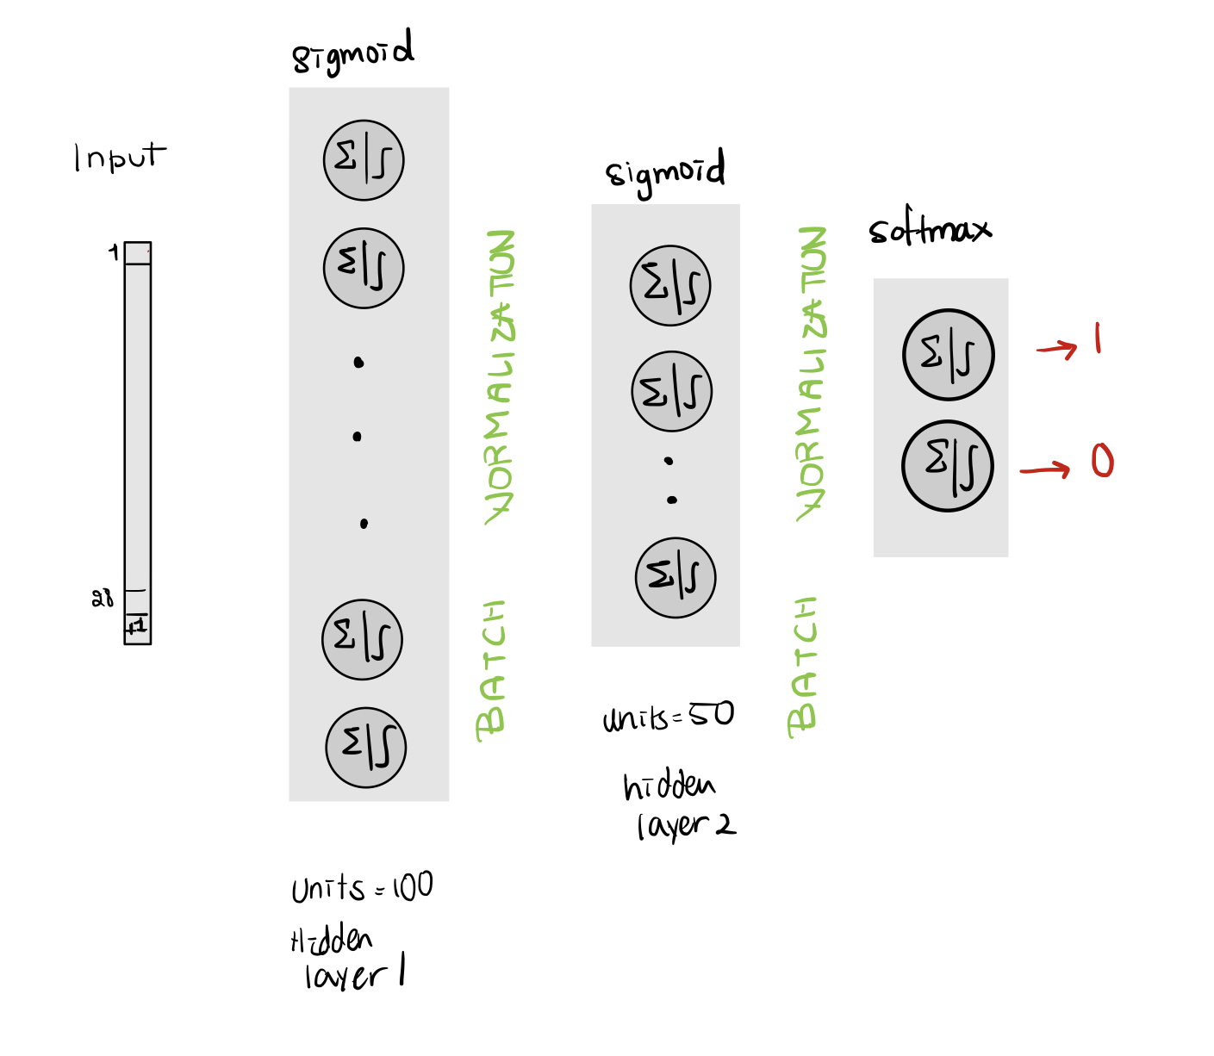
Team: Hoda Akl, Ritesh Chowdhry & Prasanth Shyamsundar
Test accuracy: 76.45%
Loss: Categorical Cross Entropy
Batches of 200
Optimizer: Adam
Early stopping: monitoring validation loss
Trained for 200 Epochs

